Slide 1


Computer Graphic
Week 7 : Curve

Slide 2
Lines vs Curve
end point
direction
end point
end point
direction
end point
In the past, you have probably specified a line by the position of it’s end points. The breshenham or other algorithms simply draw a straight line between the two points
A curve allows you to specify, not only the end points of the line, but also the direction of the line as it passes through the end points.
The algorithm draws a curve that passes through the end points at an angle parallel to the specified direction.

Slide 3
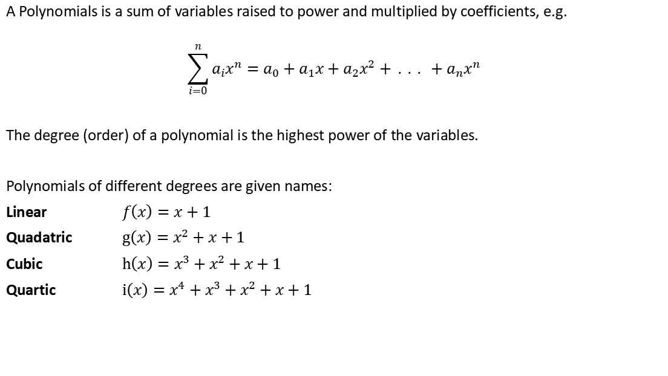
A Polynomials is a sum of variables raised to power and multiplied by coefficients, e.g.
$$\sum_{i=0}^{n}{a_{i}x^{n}=a_{0}+a_{1}x+a_{2}x^{2}+ . . . +a_{n}x^{n}}$$
The degree (order) of a polynomial is the highest power of the variables.
Polynomials of different degrees are given names:
Linear $f\left(x\right)=x+1$
Quadatric $g\left(x\right)=x^{2}+x+1$
Cubic $h\left(x\right)=x^{3}+x^{2}+x+1$
Quartic $i\left(x\right)=x^{4}+x^{3}+x^{2}+x+1$

Slide 4
Bezier Curve

Slide 5
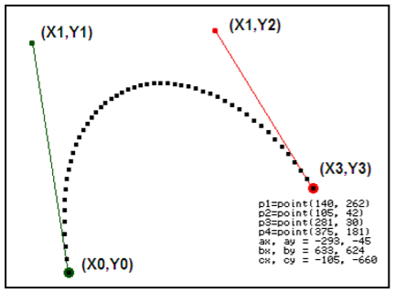
Bezier Curve
Bezier curves are used in computer graphics to produce curves which appear reasonably smooth at all scales (as opposed to polygonal lines, which will not scale nicely).
Bezier curves are named after their inventor, Dr. Pierre Bezier.
Dr. Pierre Bezier was an engineer with the Renault car company and set out in the early 1960’s to develop a curve formulation which would lend itself to shape design.
The Bezier curve is a parametric function of four points; two endpoints and two “control” points.
The curve connects the endpoints, but doesn’t necessarily touch the control points.
The general form Bezier equation, which describes each point on the curve as a function of time
Information :
(x0, y0) is the starting point.
(x3, y3) is the end point.
(x1, y1) and (x2, y2) are control points

Slide 6
Applications of Bezier Curves-
Bezier curves have their applications in the following fields-
1. Computer Graphics-
Bezier curves are widely used in computer graphics to model smooth curves. The curve is completely contained in the convex hull of its control points. So, the points can be graphically displayed & used to manipulate the curve intuitively.
2. Animation-
Bezier curves are used to outline movement in animation applications such as Adobe Flash and synfig. Users outline the wanted path in bezier curves.
The application creates the needed frames for the object to move along the path. For 3D animation, bezier curves are often used to define 3D paths as well as 2D curves.
3. Fonts-
True type fonts use composite bezier curves composed of quadratic bezier curves.
Modern imaging systems like postscript, asymptote etc use composite bezier curves composed of cubic bezier curves for drawing curved shapes.

Slide 7
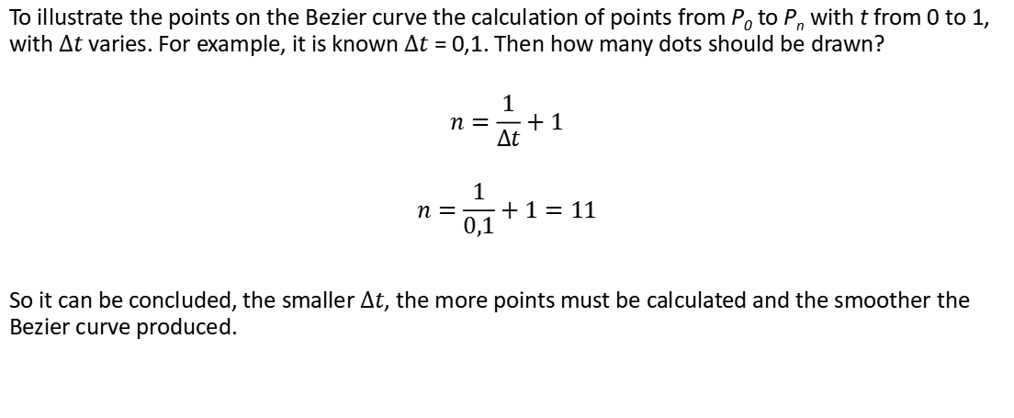

To illustrate the points on the Bezier curve the calculation of points from P₀ to P_{n} with t from 0 to 1, with $∆t$ varies. For example, it is known $∆t$= 0,1. Then how many dots should be drawn?
$$n=\frac{1}{∆t}+1$$
$$n=\frac{1}{0,1}+1=11$$
So it can be concluded, the smaller $∆t$, the more points must be calculated and the smoother the Bezier curve produced.
n = 11
$∆t$= 0,1
P₀
P₁
P₂
P₃
P₄
P₅
P₆
P₇
P₈
P₉
P₁₀
P₁₁
Notes:
Untuk menggambarkan titik-titik pada kurva Bezier maka dilakukan perhitungan titik dari $P0$ sampai dengan Pn dengan t dari 0 sampai dengan 1, dengan $∆t$ yang bervariasi

Slide 8
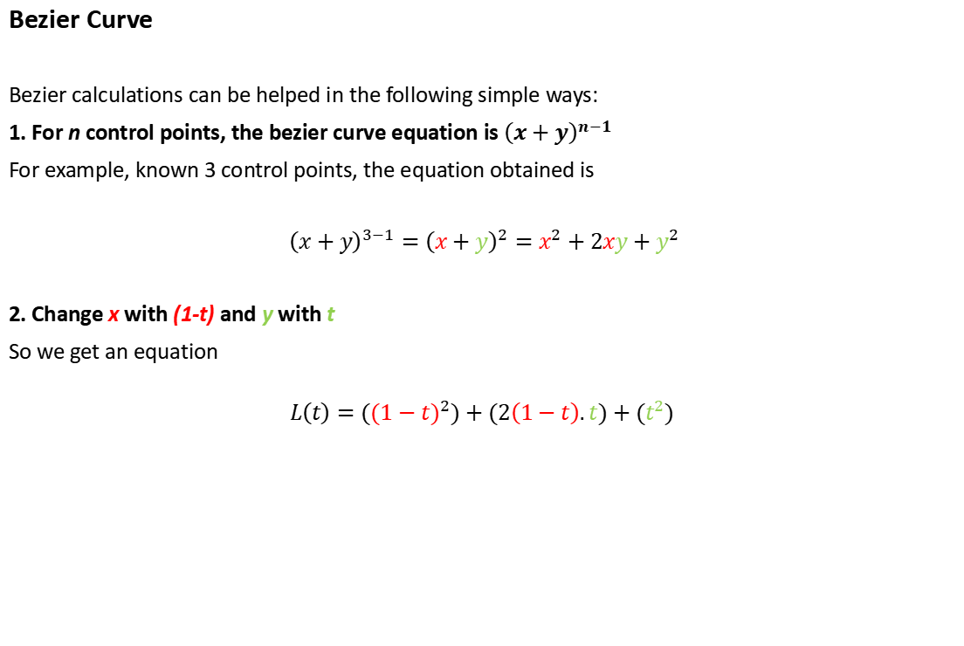
Bezier Curve
Bezier calculations can be helped in the following simple ways:
1. For n control points, the bezier curve equation is${ \left(x+y\right)}^{n−1}$
For example, known 3 control points, the equation obtained is
$${ \left(x+y\right)}^{3−1}={\left(x+y\right)}^{2}=x^{2}+2xy+y^{2}$$
2. Change x with (1-t) and y with t
So we get an equation
$$L\left(t\right)={((1−t)}^{2})+(2\left(1−t\right).t)+(t^{2})$$

Slide 9

Where 0 ≤ t ≤ 1, Let $P_{0}$ = ($x_{0}$, $y_{0}$), $P_{1}$ = ($x_{1}$, $y_{1}$) and $P$ = ($x$, $y$) then
$$P\left(t\right)=\left(1−t\right)P_{0}+tP_{1}$$
A parameter t is used to determine the value of the variables, e.g.,
$$x\left(t\right)=\left(1−t\right)x_{0}+tx_{1}$$
$$y\left(t\right)=\left(1−t\right)y_{0}+ty_{1}$$
t = 1
t = ½
P₁
t = 0
P₀

Slide 10

Linear Bézier Curves
Given points $P_{0}$ and $P_{1}$, a linear Bézier curve is simply a straight line between those two points. The curve is given by
$${ \left(x+y\right)}^{2−1}={\left(x+y\right)}^{1}=x+y$$
$$B\left(t\right)=P_{0}+t\left(P_{1}−P_{0}\right)=\left(1−t\right)P_{0}+tP_{1}$$
Linear Bezier is curve with order n = 1
The t in the function for a linear Bézier curve can be thought of as describing how far B(t) is from $P_{0}$ to $P_{1}$.
For example, when t=0,25, B(t) is one quarter of the way from $P_{0}$ to $P_{1}$.
As t varies from 0 to 1, B(t) describes a curved line from $P_{0}$ to $P_{1}$

Slide 11

Quadratic Bézier Curves
A quadratic Bézier curve is the path traced by the function B(t), given points $P_{0}$, $P_{1}$, and $P_{2}$
$${ \left(x+y\right)}^{3−1}={\left(x+y\right)}^{2}=x^{2}+2xy+y^{2}$$
$$B\left(t\right)={\left(1−t\right)}^{2}P_{0}+2\left(1−t\right)tP_{1}+ t^{2}P_{2}, t ∈[0,1]$$
Quadratic Bezier is curve with order n = 2
For quadratic Bézier curves one can construct 1 intermediate points $Q_{0}$ and $Q_{1}$ such that as t varies from 0 to 1:
Point $Q_{0}$ varies from $P_{0}$ to $P_{1}$ and describes a linear Bézier curve.
Point $Q_{1}$ varies from $P_{1}$ tp $P_{2}$ and describes a linear Bézier curve.
Point B(t) varies from $Q_{0}$ to $Q_{1}$ and describes a quadratic Bézier curve

Slide 12
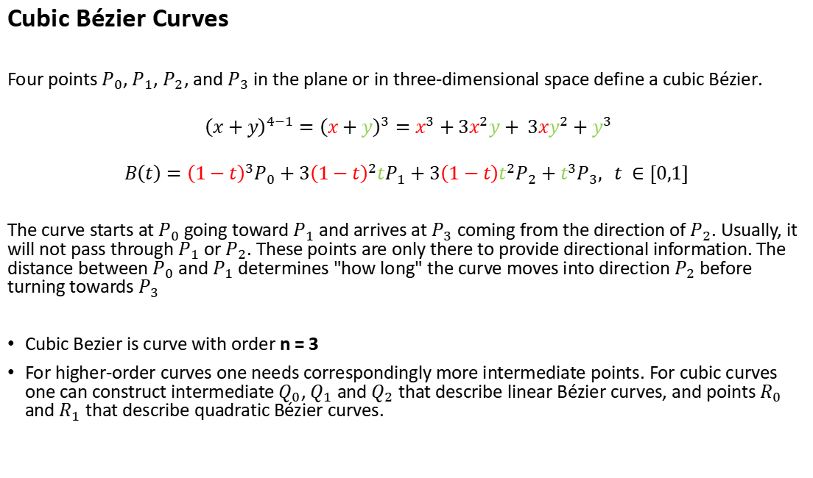
Cubic Bézier Curves
Four points $P_{0}$, $P_{1}$, $P_{2}$, and $P_{3}$ in the plane or in three-dimensional space define a cubic Bézier.
$${ \left(x+y\right)}^{4−1}={\left(x+y\right)}^{3}=x^{3}+3x^{2}y+ 3xy^{2}+y^{3}$$
$$B\left(t\right)={\left(1−t\right)}^{3}P_{0}+3{\left(1−t\right)}^{2}tP_{1}+3\left(1−t\right)t^{2}P_{2}+t^{3}P_{3}, t ∈[0,1]$$
The curve starts at $P_{0}$ going toward $P_{1}$ and arrives at $P_{3}$ coming from the direction of $P_{2}$. Usually, it will not pass through $P_{1}$ or $P_{2}$. These points are only there to provide directional information. The distance between $P_{0}$ and $P_{1}$ determines "how long" the curve moves into direction $P_{2}$ before turning towards $P_{3}$
Cubic Bezier is curve with order n = 3
For higher-order curves one needs correspondingly more intermediate points. For cubic curves one can construct intermediate $Q_{0}$, $Q_{1}$ and $Q_{2}$ that describe linear Bézier curves, and points $R_{0}$ and $R_{1}$ that describe quadratic Bézier curves.
Notes:
$${ \left(x+y\right)}^{4−1}={\left(x+y\right)}^{3}=x^{3}+3x^{2}y+ 3xy^{2}+y^{3}$$

Slide 13
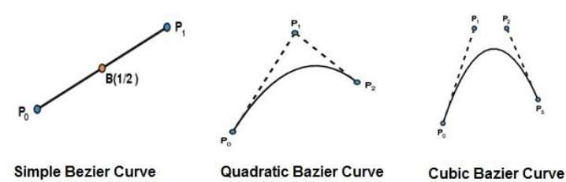
Degree = Number of Control Points – 1

Slide 14
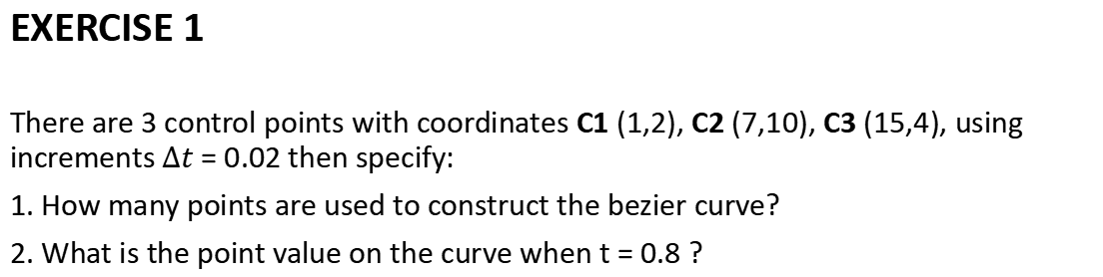
EXERCISE 1
There are 3 control points with coordinates C1 (1,2), C2 (7,10), C3 (15,4), using increments $∆t$ = 0.02 then specify:
1. How many points are used to construct the bezier curve?
2. What is the point value on the curve when t = 0.8 ?
C2 (7,10)
C3 (15,4)
C1 (1,2)

Slide 15

Solution
a. With an increase of 0.02, the number of points needed between 0 and 1 is
$$\frac{1}{∆t}+1=\frac{1}{0.02}+1=51 points$$
b. Because it consists of 3 control points the equation becomes
$${(x+y)}^{3−1}={(x+y)}^{2}$$
$$x^{2}+2xy+y^{2}=0$$
$$x=\left(1−t\right) dan y=t$$
Then the equation becomes:
$$L\left(t\right)={\left(1−t\right)}^{2}+2\left(1−t\right)t+t^{2}$$

Slide 16

The point for t = 0.8
$$x={(1−t)}^{2}.x1+2\left(1−t\right)t.x2+t^{2}.x3$$
$$y={(1−t)}^{2}.y1+2(1−t)t.y2+t^{2}.y3$$
x1, x2, x3, y1, y2 and y3 are taken from the control point C1 (1, 2); C2 (7, 10); C3 (15, 4)
$$x={\left(1−0,8\right)}^{2}(1)+(2)\left(1−0,8\right)(0,8)(7)+{(0,8}^{2})(15)$$
$$x=0,04+2,24+9,6=11,88=12$$
$$y={\left(1−0,8\right)}^{2}(2)+(2)\left(1−0,8\right)(0,8)(10)+{(0,8}^{2})(4)$$
$$y=0,08+3,2+2,56=5,84=6$$
The point value on the curve when t = 0.8 is (12, 6)
t = 0.8
(12, 6)
C2 (7,10)
C3 (15,4)
C1 (1,2)

Slide 17
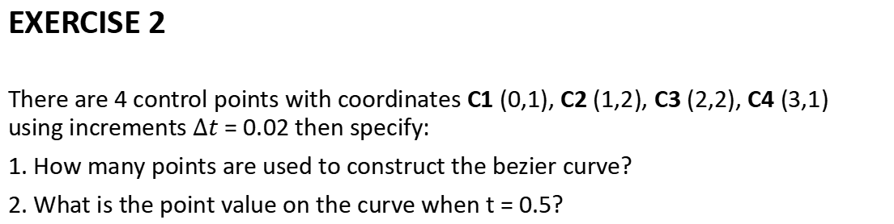
EXERCISE 2
There are 4 control points with coordinates C1 (0,1), C2 (1,2), C3 (2,2), C4 (3,1) using increments $∆t$ = 0.02 then specify:
1. How many points are used to construct the bezier curve?
2. What is the point value on the curve when t = 0.5?
C2 (1,2)
C3 (2,2)
C1 (0,1)
C4 (3,1)

Slide 18

Solution
a. With an increase of 0.02, the number of points needed between 0 and 1 is
$$\frac{1}{∆t}+1=\frac{1}{0.02}+1=51 points$$
b. Because it consists of 4 control points the equation becomes
$${(x+y)}^{4−1}={(x+y)}^{3}$$
$$x^{3}+3x^{2}y+3xy^{2}+y^{3}=0$$
$$x=\left(1−t\right) dan y=t$$
Then the equation becomes:
$$L\left(t\right)={\left(1−t\right)}^{3}+3{\left(1−t\right)}^{2}t+3\left(1−t\right)t^{2}+t^{3}=0$$

Slide 19

The point for t = 0.8
$$x={(1−t)}^{2}.x1+2\left(1−t\right)t.x2+t^{2}.x3$$
$$y={(1−t)}^{2}.y1+2(1−t)t.y2+t^{2}.y3$$
x1, x2, x3, y1, y2 and y3 are taken from the control point C1 (1, 2); C2 (7, 10); C3 (15, 4)
$$x={\left(1−0,8\right)}^{2}(1)+(2)\left(1−0,8\right)(0,8)(7)+{(0,8}^{2})(15)$$
$$x=0,04+2,24+9,6=11,88=12$$
$$y={\left(1−0,8\right)}^{2}(2)+(2)\left(1−0,8\right)(0,8)(10)+{(0,8}^{2})(4)$$
$$y=0,08+3,2+2,56=5,84=6$$
The point value on the curve when t = 0.8 is (12, 6)
t = 0.8
(12, 6)
C2 (7,10)
C3 (15,4)
C1 (1,2)

Slide 20

The point for t = 0.5
$$x={(1−t)}^{3}.x1+3{(1−t)}^{2}t.x2+3(1−t)t^{2}.x3+t^{3}.x4$$
$$y={(1−t)}^{3}.y1+3{(1−t)}^{2}t.y2+3(1−t)t^{2}.y3+t^{3}.y4$$
x1, x2, x3, x4, y1, y2, y3 and y4 are taken from the control point C1 (0, 1), C2 (1, 2), C3 (2, 2), C4 (3, 1)
$$x={\left(1−0.5\right)}^{3}(0)+(3){\left(1−0.5\right)}^{2}(0.5)(1)+(3)\left(1−0.5\right){\left(0.5\right)}^{2}(2)+{\left(0.5\right)}^{3}(3)$$
$$x=0+0,375+0,75+0,375=1,5$$
$$y={\left(1−0.5\right)}^{3}(1)+(3{)\left(1−0.5\right)}^{2}(0.5)(2)+(3)\left(1−0.5\right){\left(0.5\right)}^{2}(2)+({0.5)}^{3}(1)$$
$$y=0.125+0.75+0.75+0.125=1.75$$
The point value on the curve when t = 0.5 is (1.5, 1.75)
t = 0.8
(1.5, 1.75)
C2 (1,2)
C3 (2,2)
C1 (0,1)
C4 (3,1)

Slide 21
EXERCISE

Slide 22
Given a bezier curve with 4 control points-
B0[1 0] , B1[3 3] , B2[6 3] , B3[8 1]
Determine any 5 points lying on the curve. Also, draw a rough sketch of the curve.

Slide 23

$$L\left(t\right)={\left(1−t\right)}^{3}+3{\left(1−t\right)}^{2}t+3\left(1−t\right)t^{2}+t^{3}=0$$
for t = 0
P(0) = [1 0](1-0)3 + [3 3]3(0)(1-t)2 + [6 3]3(0)2(1-0) + [8 1](0)3
P(0) = [1 0] + 0 + 0 + 0
P(0) = [1 0]

Slide 24
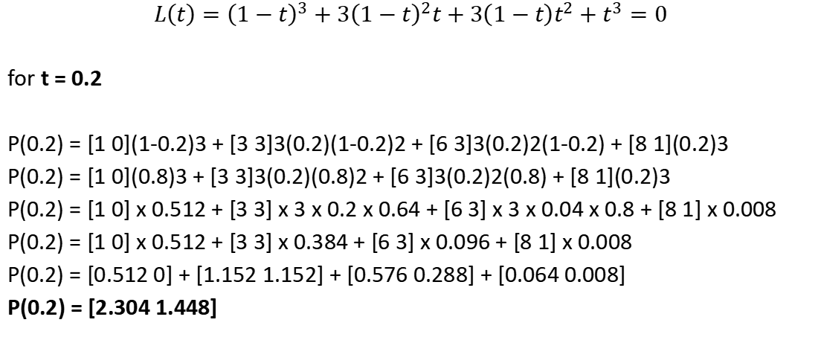
$$L\left(t\right)={\left(1−t\right)}^{3}+3{\left(1−t\right)}^{2}t+3\left(1−t\right)t^{2}+t^{3}=0$$
for t = 0.2
P(0.2) = [1 0](1-0.2)3 + [3 3]3(0.2)(1-0.2)2 + [6 3]3(0.2)2(1-0.2) + [8 1](0.2)3
P(0.2) = [1 0](0.8)3 + [3 3]3(0.2)(0.8)2 + [6 3]3(0.2)2(0.8) + [8 1](0.2)3
P(0.2) = [1 0] x 0.512 + [3 3] x 3 x 0.2 x 0.64 + [6 3] x 3 x 0.04 x 0.8 + [8 1] x 0.008
P(0.2) = [1 0] x 0.512 + [3 3] x 0.384 + [6 3] x 0.096 + [8 1] x 0.008
P(0.2) = [0.512 0] + [1.152 1.152] + [0.576 0.288] + [0.064 0.008]
P(0.2) = [2.304 1.448]

Slide 25
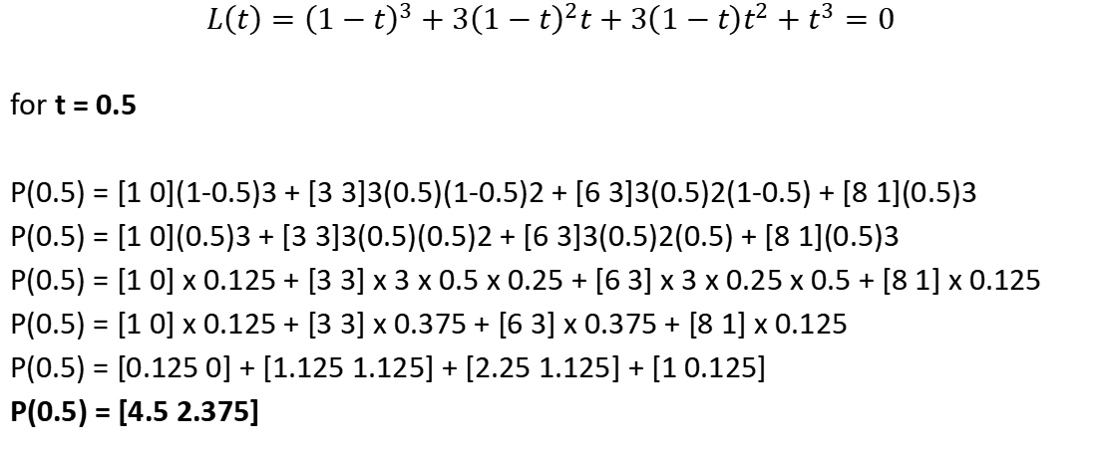
$$L\left(t\right)={\left(1−t\right)}^{3}+3{\left(1−t\right)}^{2}t+3\left(1−t\right)t^{2}+t^{3}=0$$
for t = 0.5
P(0.5) = [1 0](1-0.5)3 + [3 3]3(0.5)(1-0.5)2 + [6 3]3(0.5)2(1-0.5) + [8 1](0.5)3
P(0.5) = [1 0](0.5)3 + [3 3]3(0.5)(0.5)2 + [6 3]3(0.5)2(0.5) + [8 1](0.5)3
P(0.5) = [1 0] x 0.125 + [3 3] x 3 x 0.5 x 0.25 + [6 3] x 3 x 0.25 x 0.5 + [8 1] x 0.125
P(0.5) = [1 0] x 0.125 + [3 3] x 0.375 + [6 3] x 0.375 + [8 1] x 0.125
P(0.5) = [0.125 0] + [1.125 1.125] + [2.25 1.125] + [1 0.125]
P(0.5) = [4.5 2.375]

Slide 26
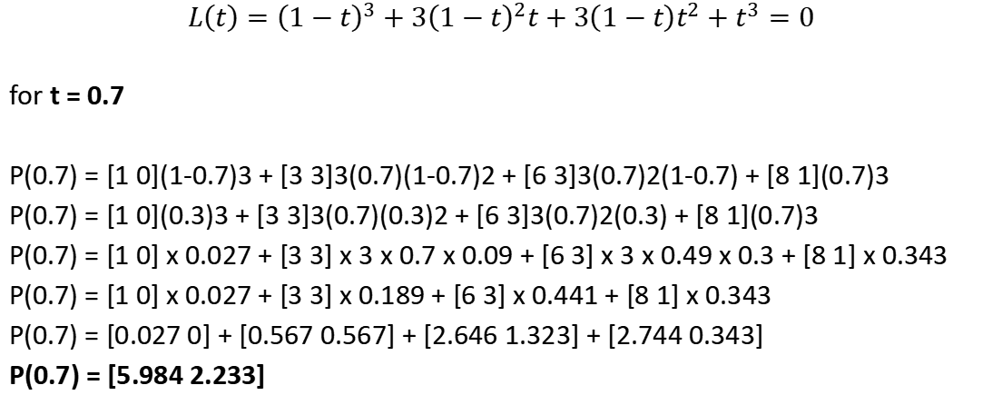
$$L\left(t\right)={\left(1−t\right)}^{3}+3{\left(1−t\right)}^{2}t+3\left(1−t\right)t^{2}+t^{3}=0$$
for t = 0.7
P(0.7) = [1 0](1-0.7)3 + [3 3]3(0.7)(1-0.7)2 + [6 3]3(0.7)2(1-0.7) + [8 1](0.7)3
P(0.7) = [1 0](0.3)3 + [3 3]3(0.7)(0.3)2 + [6 3]3(0.7)2(0.3) + [8 1](0.7)3
P(0.7) = [1 0] x 0.027 + [3 3] x 3 x 0.7 x 0.09 + [6 3] x 3 x 0.49 x 0.3 + [8 1] x 0.343
P(0.7) = [1 0] x 0.027 + [3 3] x 0.189 + [6 3] x 0.441 + [8 1] x 0.343
P(0.7) = [0.027 0] + [0.567 0.567] + [2.646 1.323] + [2.744 0.343]
P(0.7) = [5.984 2.233]

Slide 27
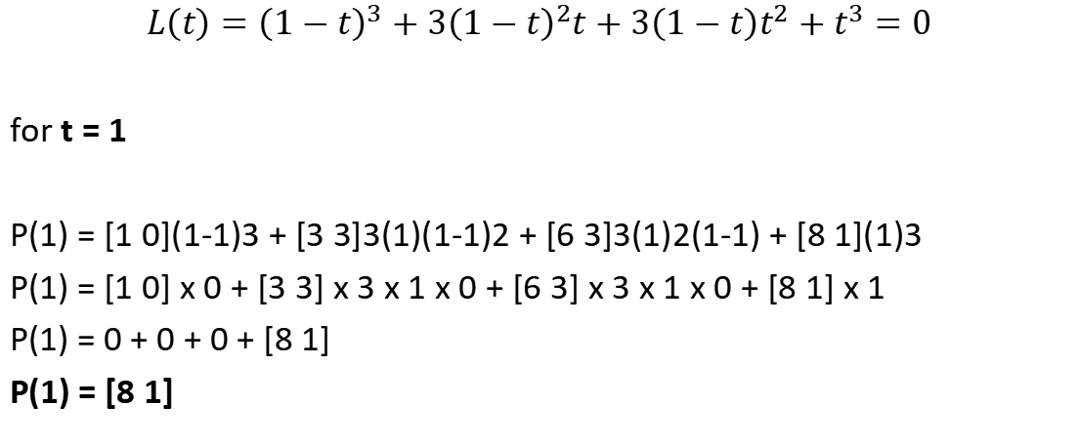
$$L\left(t\right)={\left(1−t\right)}^{3}+3{\left(1−t\right)}^{2}t+3\left(1−t\right)t^{2}+t^{3}=0$$
for t = 1
P(1) = [1 0](1-1)3 + [3 3]3(1)(1-1)2 + [6 3]3(1)2(1-1) + [8 1](1)3
P(1) = [1 0] x 0 + [3 3] x 3 x 1 x 0 + [6 3] x 3 x 1 x 0 + [8 1] x 1
P(1) = 0 + 0 + 0 + [8 1]
P(1) = [8 1]

Slide 28
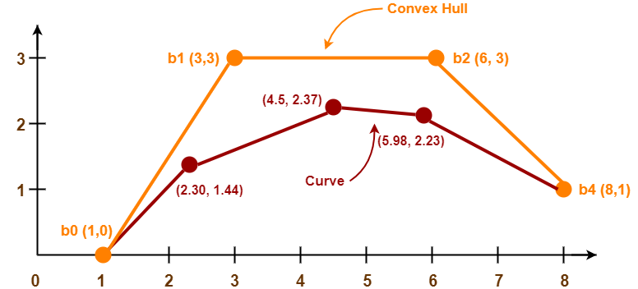

Slide 29
THANKYOU

